Slide 1
Arrays and User-defined data types in C

Slide 2
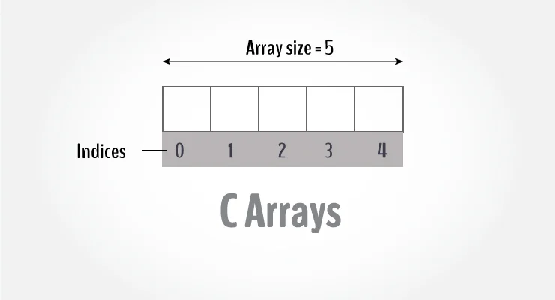
C Arrays
Arrays are used to store a fixed-size sequential collection of elements of the same type.
To declare an array in C, specifies the type of the elements and the number of elements required by an array.
type arrayName [ arraySize ];
For example, if you want to store 100 integers, you can
create an array for it.
int data[100];
The size and type of an array cannot be changed once
it is declared.

Slide 3
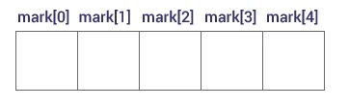
Access Array Elements
You can access elements of an array by indices.
The first element is mark[0], the second element is mark[1] and so on.
Arrays have 0 as the first index, not 1.
If the size of an array is n, to access the last element, the n-1 index is used.

Slide 4
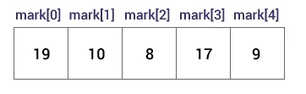
How to initialize an array?
C++ array elements can be initialized either one by one or using a single statement as follows:
int mark[5] = {19, 10, 8, 17, 9};
Or:
int mark[5];
mark[0] = 19;
mark[1] = 10;
If you omit the size of the array, an array just big enough to hold the initialization is created.
int mark[] = {19, 10, 8, 17, 9};

Slide 5
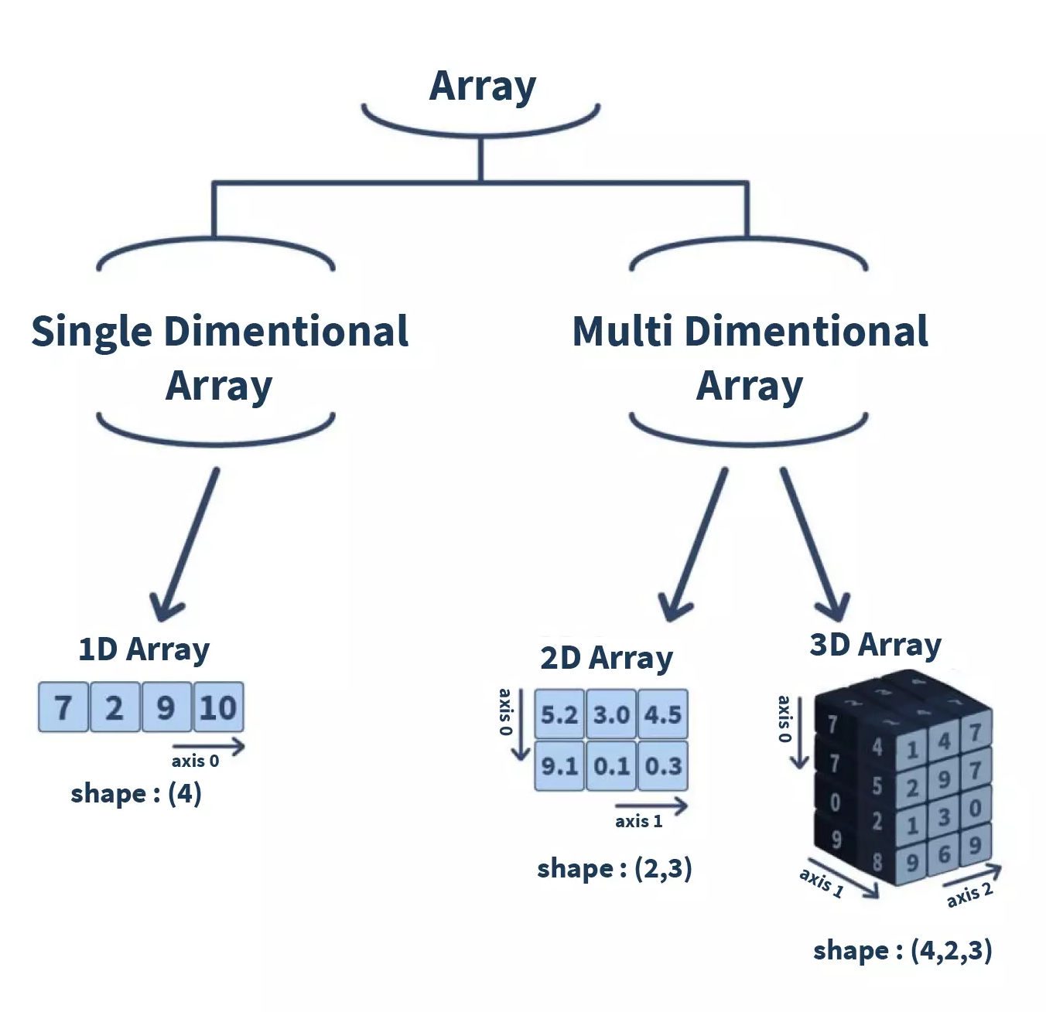
Types of array
Array is a collection of similar types of data present in the contiguous memory location. It is divided into two basic types: single-dimensional(1D and multi-dimensional Array. The multi-dimensional arrays can be further divided into two-dimensional (2-D), three-dimensional (3-D), and n-dimensional (N-D) arrays.

Slide 6
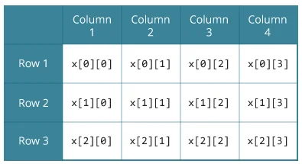
C Multidimensional Arrays
You can create an array of arrays. These arrays are
known as multidimensional arrays.
For example,
float x[3][4];
Here, x is a two-dimensional (2d) array.
The array can hold 12 elements.
It is a table with 3 rows and each row has 4 columns.

Slide 7
Initializing a multidimensional array
Initialization of a 2d array
// Different ways to initialize a two-dimensional array
int c[2][3] = {{1, 3, 0}, {-1, 5, 9}};
int c[][3] = {{1, 3, 0}, {-1, 5, 9}};
int c[2][3] = {1, 3, 0, -1, 5, 9};

Slide 8
Initializing a multidimensional array
Initialization of a 3d array
int test[2][3][4] = {
{{3, 4, 2, 3}, {0, -3, 9, 11}, {23, 12, 23, 2}},
{{13, 4, 56, 3}, {5, 9, 3, 5}, {3, 1, 4, 9}}};

Slide 9
Properties of Array
The array contains the following properties.
Each element of an array is of same data type and carries the same size, i.e., int = 4 bytes.
Elements of the array are stored at contiguous memory locations where the first element is stored at the smallest memory location.
Elements of the array can be randomly accessed since we can calculate the address of each element of the array with the given base address and the size of the data element.

Slide 10
Advantage of C Array
1) Code Optimization: Less code to the access the data.
2) Ease of traversing: By using the for loop, we can retrieve the elements of an array easily.
3) Ease of sorting: To sort the elements of the array, we need a few lines of code only.
4) Random Access: We can access any element randomly using the array.
Disadvantage of C Array
1) Fixed Size: Whatever size, we define at the time of declaration of the array, we can't exceed the limit. So, it doesn't grow the size dynamically like LinkedList which we will learn later.

Slide 11
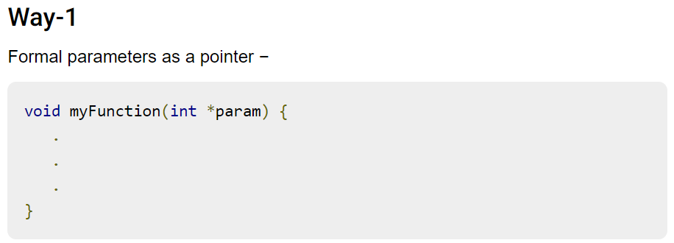
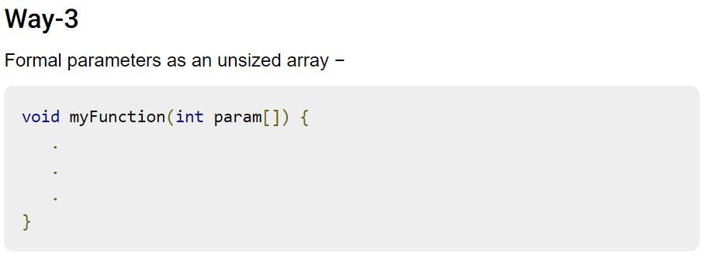
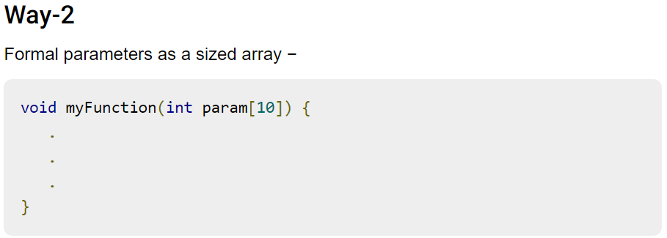
Passing arrays to functions
Just like normal variables, Arrays can also be passed to a function as an argument, but in C whenever we pass an array as a function argument then it is always treated as a pointer by a function. Pointers not only have the capability of storing the address of a single variable but they can also store the address of cells of an array.

Slide 12
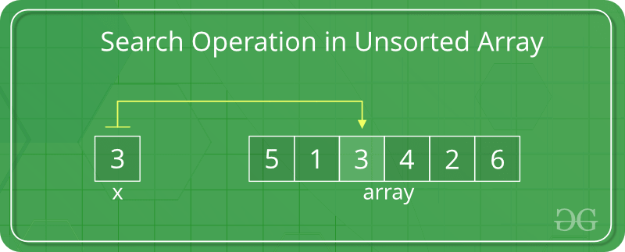
Search Operation in an array
In an unsorted array, the search operation can be performed by linear traversal from the first element to the last element.
// Function to implement search operation
int findElement(int arr[], int n, int key)
{
int i;
for (i = 0; i < n; i++)
if (arr[i] == key)
return i;
// If the key is not found
return -1;
}

Slide 13
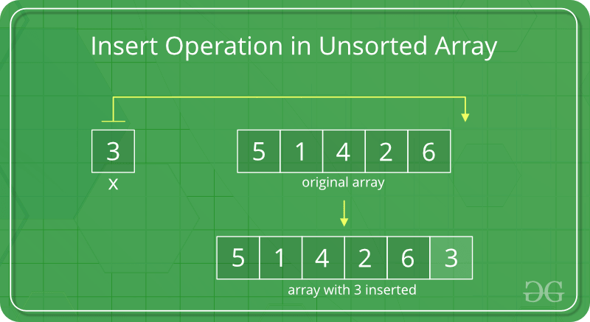
Insert elements to an array
Elements can be inserted to an array in two ways.
Insert at the end of the list
Insert at any position
Insert at the end:
In an unsorted array, the insert operation is faster as compared to a sorted array because we don’t have to care about the position at which the element is to be placed.

Slide 14
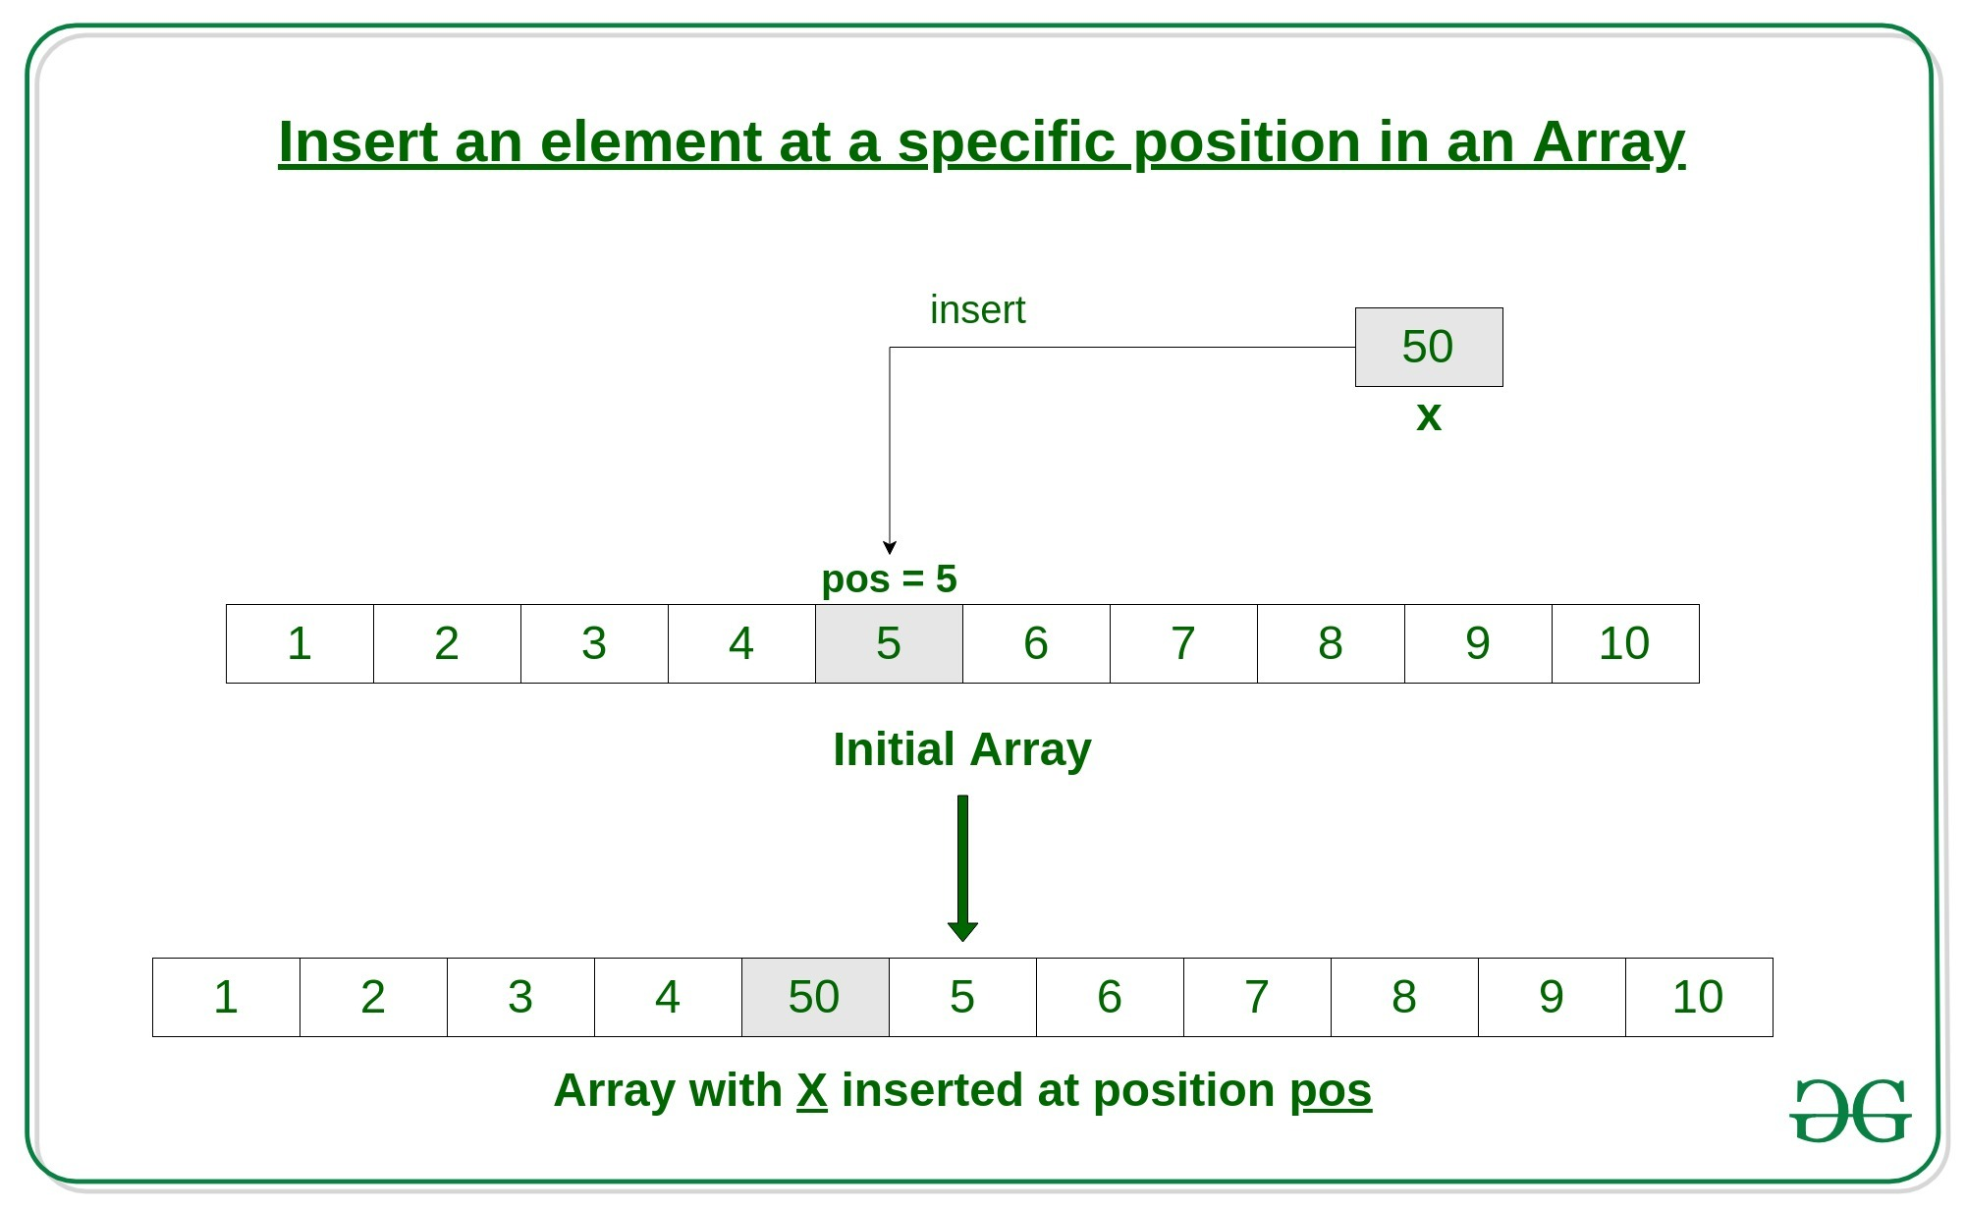
Insert at any position
Insert operation in an array at any position can be performed by shifting elements to the right, which are on the right side of the required position

Slide 15
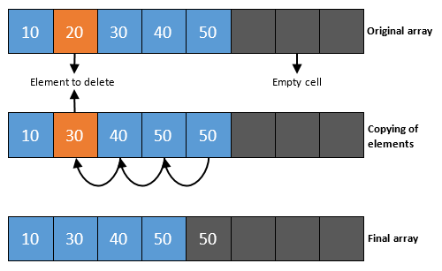
Remove an element from an array in C
To delete a specific element from an array, a user must define the position from which the array's element should be removed. The deletion of the element does not affect the size of an array.

